Slide 1
BASICS OF PROGRAMMING
SETTING THE STAGE

Slide 2

OUTLINE
Programming Fundamentals
Code Components
Designing Using Pseudo-Code
From Pseudo-Code to Runnable Code

Slide 3
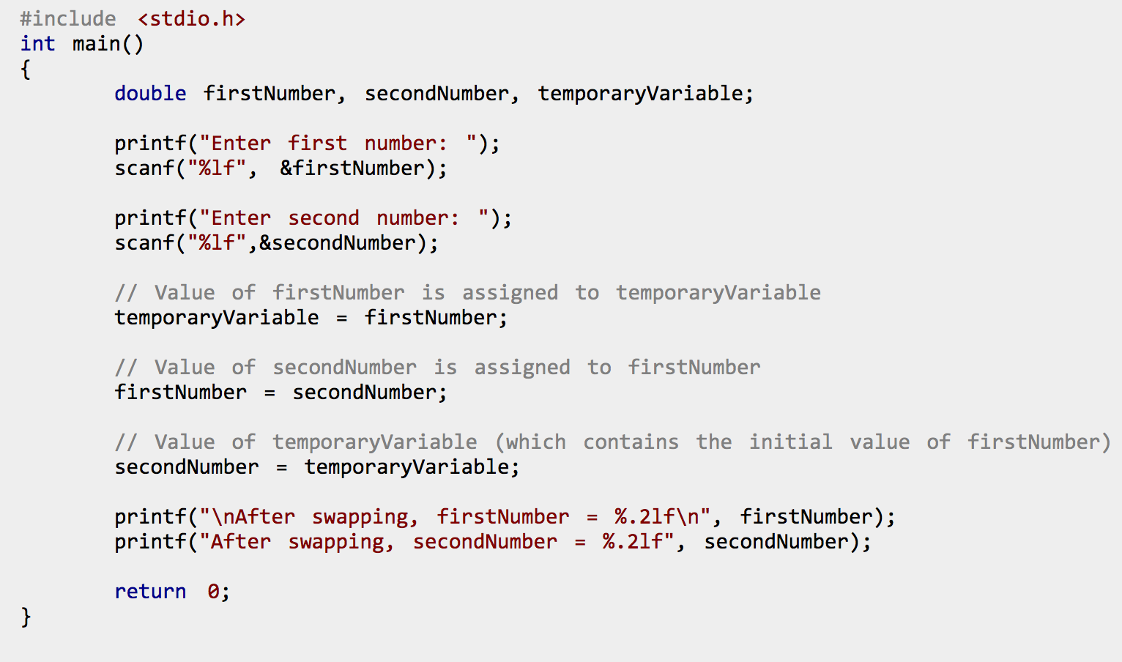
Computer Program: Example in C
An algorithm written in a computer language, providing instructions to a computer for carrying out a series of operations

Slide 4
Computer Program: Definition
An algorithm, written in a computer language, that provides instructions to a computer for carrying out a sequence of operations.
It can be compiled or interpreted as a series of hardware operations, carried out by the electrical components of a computer.

Slide 5
Formal LANGUAGE: EXAMPLE
Alphabet: {‘a’, ‘b’, ‘C’, ‘D’,’!’}
Rules (Grammar):
letters may be placed to the left or right of another letter
a letter instance must always have another instance of the same letter to either the left or the right
upper case letters must always have a lower case letter to the left or right

Slide 6
Formal LANGUAGE: DEFINITION
In a formal language:
words are created from a pre-defined alphabet
a grammar provides rules about how letters may be combined to form words

Slide 7
Computer Language: Definition
A (formal) language constructed to provide instructions to a computer, such that it can be compiled into low-level instructions that the computer processor can carry out.

Slide 8
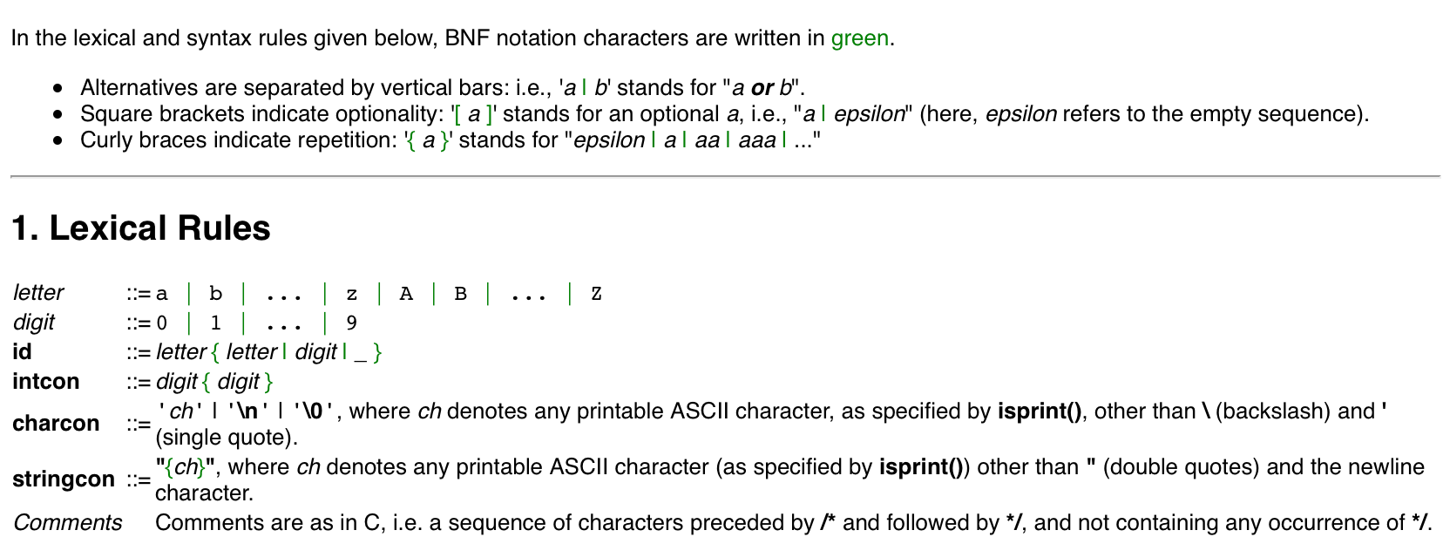
Computer Language: FORMAL DEFINITION OF C
A language constructed to provide instructions to a computer

Slide 9
Computer Program: Definition
An algorithm, written in a computer language, that provides instructions to a computer for carrying out a sequence of operations.
It can be compiled or interpreted as a series of hardware operations, carried out by the electrical components of a computer.

Slide 10
Algorithm: Example
Pour ½ cup flour into bowl
Break one egg into bowl
Pour 3 tablespoons oil into bowl
Pour 1 teaspoon baking powder into bowl
Mix with spoon until smooth
Pour mixture into muffin tins
Bake for 15 minutes at 350 degrees Fahrenheit

Slide 11
Algorithm: Definition
A sequence of instructions which have one or more well defined stopping points.

Slide 12
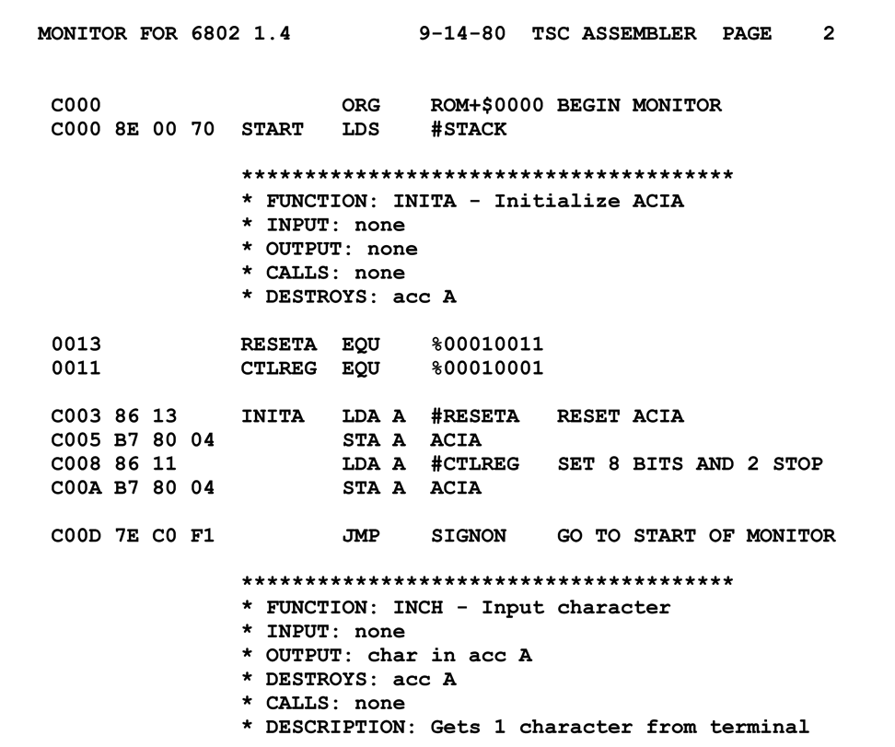
Computer Program: Details
Higher level computer languages are compiled into (or interpreted as) ‘machine code’ – a series of very basic instructions that tell the computer hardware how to behave.
When the computer is carrying out the instructions, we say it is ‘running’ the program – as a process
We can instruct a computer to run a program. Computers can also tell themselves to run programs!

Slide 13
Computer Programs: The Big PICTURE
All computers operate by running (compiled) computer programs.
The internet is a collection of computers connected by physical wires or radio wave transmitters and receivers.
Computers transmit to, and receive signals from, other computers on this network.
The signals sent from computer to computer, and what is done with received signals, are based on what programs the computers are running.
The cloud is a part of the internet loosely defined as a collection of computers used mainly to store and serve content to other computers.

Slide 14
Elements of Computer Code
Variables
Data Structures
Operators
Statements and Expressions
Blocks (and Scope)
Functions
Logical (Control) Flow
Libraries/Packages/Modules
Inputs/Outputs
Interpreters/Compilers

Slide 16
Design Components
In designing an algorithm, we need to specify:
input
output
how the input should be transformed to provide the output
From a bigger picture perspective, we can also talk about the function, or purpose of the algorithm.

Slide 17
Pseudo-code: EXAMPLE
j_cluster(array_of_points, max_n_neighbour_distance)
{
for each point[i] in array_of_points
{
for each remaining point[j] in array_of_points
{
distance_between_ij = distance(point[i], point[j])
if distance_between_ij <= max_n_neighbour_distance
then neighbours[i] = add_to_neighbours(point[i],point[j])
}
. . .

Slide 18
PseudoCode: What It Really Looked Like!

Slide 19
Pseudo-code: Description
Pseudo-code is the term for a rough sketch of an algorithm which indicates the general expected input, output and steps, but which ‘black boxes’ the details of the functions.
Keeping in mind the main elements of any computer language (e.g. variables, functions, logical flow, etc.) we can design an algorithm without using a specific language.

Slide 20
Pseudo-code: Strategy
Define an input
Define an output
Write a set of programmatic instructions that will take you from input to output
Remember that you can ‘black box’ parts of the code – describing functionality at a high level

Slide 21
Pseudo-code: LEVEL OF Abstraction
Getting a feel for the right level of detail in pseudocode takes practice.
To some extent, it depends on the level of abstraction of the programming language you will (likely) be using:
High-level languages – have a lot of built in functions
Low-level languages – many details and functions must be programmed ‘by hand’
High-level languages let you program at a higher level of abstraction.
At the same time, you may sacrifice utility for understanding.

Slide 22
The Real Deal
To go from pseudo-code to real code, there are a number of steps:
Determine the appropriate syntax of the language you want to use and rewrite your pseudo-code as real code in this language
Replace black box functions with real code
Determine how to connect your piece of code (the software) up to the computer, so your code can be compiled/interpreted, run by the computer, receive input and generate output
PSEUDO-CODE
CODE-CODE

Slide 23
From Code To Computer
Many roadblocks can arise when going from code – which is just text files – to having code that runs on your computer. These roadblocks can include:
libraries
input/output + file system
compilers/interpreters
In broad terms, a certain amount of infrastructure must be in place!
We are taking care of much of this for you by setting up notebooks for you.

Slide 24
Programming Resources
Much of the information about how to use a particular computer language or how to make code run on a particular hardware configuration, is not written down in any single authoritative reference manual.
This is likely because the world of coding and computers changes so quickly.
To successfully code, you must be embedded in a community of coders. Luckily, the internet has made this much easier – most questions about coding have already been answered somewhere on the internet.
In short – STACK EXCHANGE (and other similar sites)

Slide 25
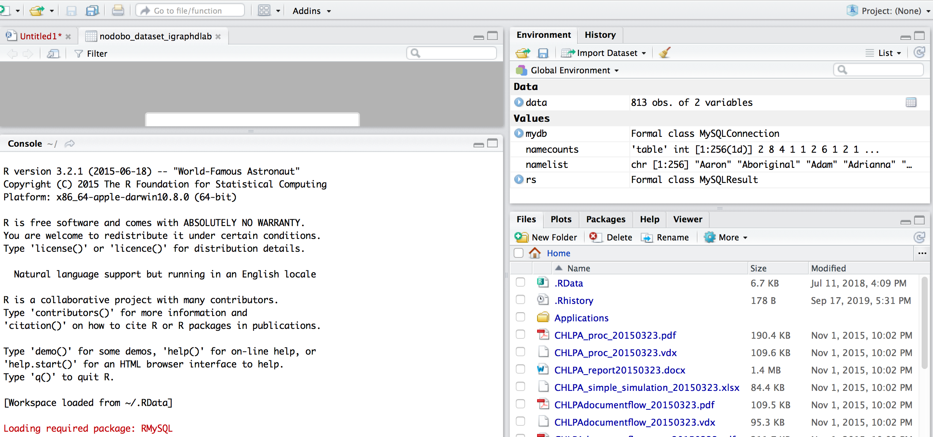
R Studio

Slide 26
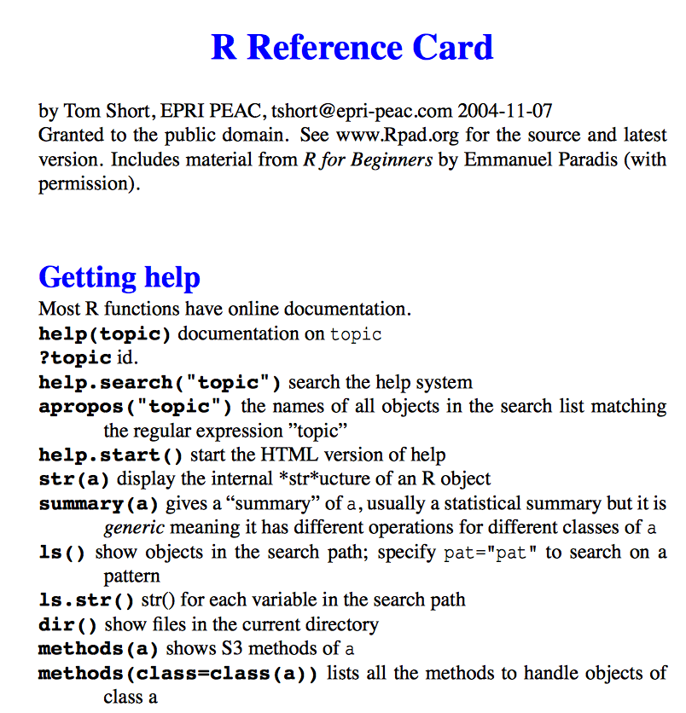
Components of R Computer Code
Variables
Data Structures
Operators
Statements and Expressions
Blocks (and Scope)
Functions
Logical (Control) Flow
Libraries/Packages/Modules
Inputs/Outputs
Interpreters/Compilers

Slide 27
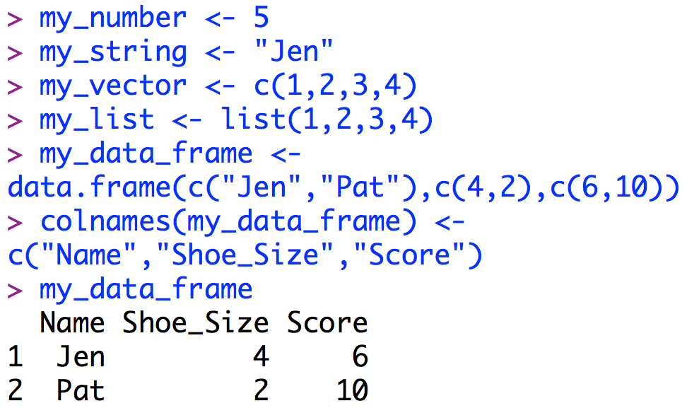
R: Some Key INFO (I)
To create a variable in R, simply come up with a name and use the assignment operator to assign a value to the variable
The value might be of variable types: number, character, string, vector, list, matrix, data frame or some other object
R uses the data frame object a lot!

Slide 28
Object Oriented vs Procedural Languages
R and Python are objected oriented languages, as opposed to procedural languages.
What does this mean?
To understand the answer we must first understand:
Data Types
Data structures
Functions

Slide 29
Data Types
Languages have a set of built in basic variable types – e.g.:
Integer: 5
Character: ‘m’
List: (5, 3, 9)
Other variables types can be built up out of these basic types – e.g.:
String = list of characters: (‘t’, ‘a’, ‘b’, ‘l’, ‘e’)

Slide 30
Data StructureS and Objects
A user might want to define their own set of related variables – a data structure:
struct myNames = {string firstName, string middleName, string lastName}
jenNames might be a variable of type myNames, with firstName = Jen, middleName = Adele, lastName = Schellinck
In addition a programmer might want to always be able to carry out a set of predefined instructions, or functions, on that data structure:
jenNames.print_middle_name
An object is loosely defined as a user defined data structure plus a set of functions that goes along with that data structure.

Slide 31
R data Frames
The data frame object in R is structured similar to a spreadsheet in Excel:
It has rows and columns, with associated row and column names
You can carry out predefined operations on specific values, on selected rows or selected columns
People familiar working with databases, AND people used to working with more vector-focused languages (e.g. Java) might find the data frame implementation in R frustrating!

Slide 32
Compiled vs Interpreted Languages
Compiled Language: Program is written as a whole, compiler checks the code as a whole and turns it into a low level language
Interpreted Language: Interpreter reads, turns into low-level code, and carries out one statement at a time.
Using an interpreter lets you program in a more free-form, improvisational way – like playing jazz instead of classical music.
This can be useful if you are doing exploratory work, but you can run into trouble if you use this strategy to generate larger or more substantial programs.

Slide 33
Debugging
Debugging is mostly about revealing what is in memory at different points in the control flow of the code – is the code doing what you think it is?
Debugging is a bit of an art form
Debugging requires you to be a detective
Debugging teaches you perseverance
There are debugging tools that can help you all of this

Slide 34
Some Relevant Computer Science Frameworks
Languages (Computer, Mark Up)
Libraries/APIs
Software (Applications, Utilities, Systems)
Code (Open-Source, Uncompiled)
Protocol/Standard
Programming Models/Styles

